Slide 1
Chapter 3.3 High-Quality Variables
CCSW 325 (Software Construction)
Notes:
Last Update: 22/8/2019
Version 1.0

Slide 2
Outline
The Power of Variable Names

Slide 3

Good Names

Slide 4
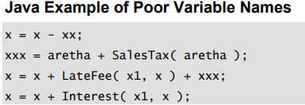

Good Names
Which variable would you use to print the customer’s bill for just the new set of purchases?
This code computed a total customer bill based on an outstanding balance and a new set of purchases.
What do x, xl, xx, and xxx mean?
What’s happening in this piece of code?
What does aretha mean?

Slide 5
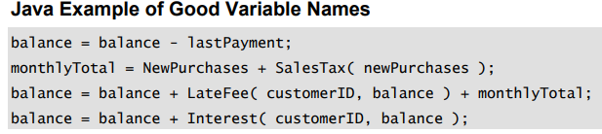

Good Names
A good variable name is readable, memorable, and appropriate

Slide 6

The Most Important Naming Consideration
The most important consideration in naming a variable is that the name fully and accurately describe the entity the variable represents.
An effective technique for coming up with a good name is to state in words what the variable represents.
Often that statement itself is the best variable name.
It’s easy to read because it doesn’t contain cryptic abbreviations, and it’s unambiguous.
It’s easy to remember because the name is similar to the concept.

Slide 7
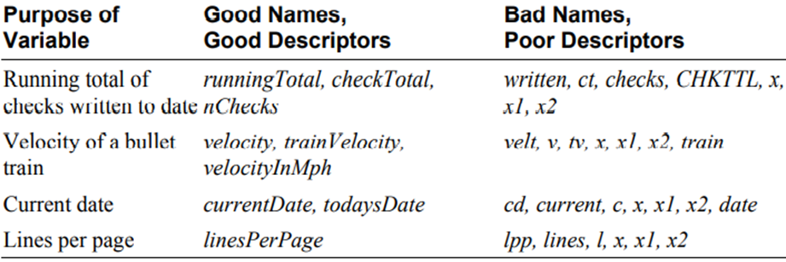
The Most Important Naming Consideration

Slide 8

Naming Specific Types of Data
Naming Loop Indexes
Guidelines for naming variables in loops have arisen because loops are such a common feature of computer programming. The names i, j, and k are customary

Slide 9
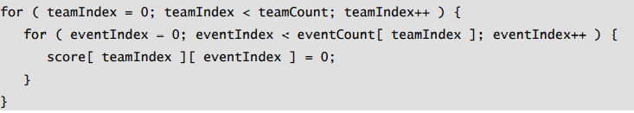
Naming Specific Types of Data
Naming Loop Indexes
If you have several nested loops, assign longer names to the loop variables to improve readability.

Slide 10
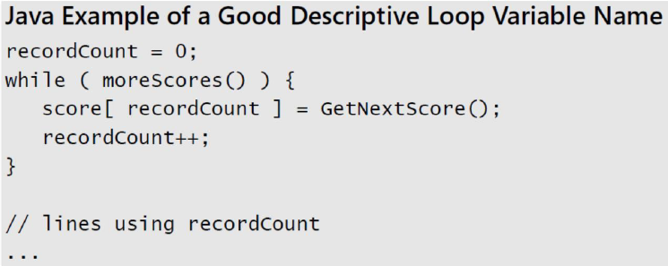
Naming Specific Types of Data
Naming Loop Indexes
If a variable is to be used outside the loop, it should be given a name more meaningful than i, j, or k.

Slide 11
Naming Specific Types of Data
Give Boolean variables names that imply True or False .
Naming Boolean Variables
Keep typical Boolean names in mind
done : Use done to indicate whether something is done. Set done to False before something is done, and set it to True when something is completed.
error : Use error to indicate that an error has occurred. Set the variable to False when no error has occurred and to True when an error has occurred.
found : Use found to indicate whether a value has been found. Set found to False when the value has not been found and to True once the value has been found.
success OR ok : Use success OR ok to indicate whether an operation has been successful. Set the variable to False when an operation has failed and to True when an operation has succeeded.

Slide 12
Naming Specific Types of Data
Naming Enumerated Types
When you use an enumerated type, you can ensure that it’s clear that members of the type all belong to the same group by using a group prefix, such as Color_, Planet_, or Month_.
Naming Constants
When naming constants, name the abstract entity the constant represents rather than the number the constant refers to.
FIVE is a bad name for a constant
CYCLES_NEEDED is a good name.
Notes:
# Define an enumerated type for days of the week with a common prefix
class Days(Enum):
MONDAY = 1 TUESDAY = 2 WEDNESDAY = 3 THURSDAY = 4 FRIDAY = 5 SATURDAY = 6 SUNDAY = 7
# Usage of the enumerated type
today = Days.FRIDAY
if today == Days.FRIDAY:
print("It's Friday, the weekend is near!")
Poorly Named Constant (Numeric Value):
FIVE = 5
CYCLES_NEEDED = 5

Slide 13
Naming Conventions When You Should Have a Naming Convention?
When multiple programmers are working on a project
When you plan to turn a program over to another programmer for modifications and maintenance (which is nearly always)
When your programs are reviewed by other programmers in your organization
When your program is so large that you can’t hold the whole thing in your brain at once and must think about it in pieces
When the program will be long-lived enough that you might put it aside for a few weeks or months before working on it again
When you have a lot of unusual terms that are common on a project and want to have standard terms or abbreviations to use in coding

Slide 14
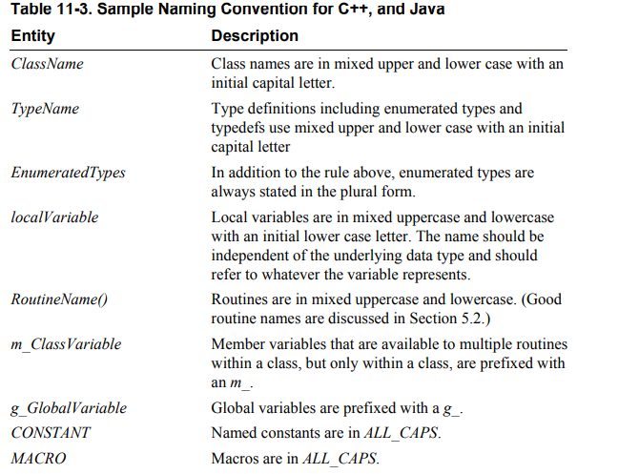
Naming Conventions Sample

Slide 15
Creating Short Names
Here are several guidelines for creating abbreviations.
Use standard abbreviations (the ones in common use, which are listed in a dictionary).
Remove all nonleading vowels. (computer becomes cmptr, and screen becomes scrn. apple becomes appl, and integer becomes intgr.)
Remove articles: and, or, the, and so on.
Use the first letter or first few letters of each word.
Truncate after the first, second, or third (whichever is appropriate) letter of each word.
Keep the first and last letters of each word.
Use every significant word in the name, up to a maximum of three words.
Remove useless suffixes—ing, ed, and so on.
Keep the most noticeable sound in each syllable.
Iterate through these techniques until you abbreviate each variable name to between 8 to 20 characters, or the number of characters to which your language limits variable names.
Notes:
Use Standard Abbreviations: Standard abbreviations that are commonly used and well-understood in the field are usually acceptable. For example, using "temp" for "temperature" or "config" for "configuration" is generally fine.
Remove Nonleading Vowels: Removing nonleading vowels can help shorten variable names while retaining readability. For example, "computer" becomes "cmptr," and "screen" becomes "scrn."
Remove Articles: Removing articles like "and," "or," "the," etc., is a good practice to reduce unnecessary words in variable names.
Use Initials or Abbreviations: You can use the first letter or a few letters of each word to create a short abbreviation. For example, "user interface" can become "UI."
Truncate Appropriately: Truncate variable names after the first, second, or third letter of each word, depending on the context and readability requirements. Be careful not to make the abbreviation too cryptic.
Keep First and Last Letters: Keeping the first and last letters of each word in the variable name can help maintain readability. For example, "calculateAverage" can become "cltAvg."
Use Every Significant Word: Include every significant word in the variable name, but limit it to a maximum of three words. For example, "maximum value" can become "maxVal."
Remove Useless Suffixes: Eliminate unnecessary suffixes like "ing," "ed," etc., if they don't add meaningful information to the variable name.
Keep Noticeable Sounds: Retain the most noticeable sound in each syllable to maintain pronunciation and recognition. For example, "information" can become "info."
Consider Language Limits: Depending on the programming language you're using, be aware of any limits on variable name lengths. Aim to keep variable names within the recommended character limit (typically 8 to 20 characters).

Slide 16
Rules for abbreviations
Don’t abbreviate by removing one character from a word
Abbreviate consistently
Create names that you can pronounce
Avoid combinations that result in mispronunciation
Use a thesaurus to resolve naming collisions
Document extremely short names with translation tables in the code
Document all abbreviations in a project-level “Standard Abbreviations” document
Remember that names matter more to the reader of the code than to the writer
Notes:
Abbreviation in coding can be a useful practice to keep variable and function names concise while maintaining readability. However, it's important to follow certain rules and best practices to ensure clarity and consistency in your codebase. Here are the rules and guidelines you mentioned:
Don't Remove a Single Character: Avoid abbreviating by removing just one character from a word, as it can make the abbreviation less meaningful and harder to understand. For example, abbreviating "length" as "lngth" is not recommended.
Abbreviate Consistently: If you decide to abbreviate a word, do so consistently throughout your codebase. Inconsistently abbreviated names can lead to confusion.
Create Pronounceable Names: Aim to create abbreviations and variable names that you can pronounce. Pronounceable names are easier to discuss and understand during code reviews and discussions.
Avoid Mispronunciations: Be cautious when combining words or using abbreviations that may result in mispronunciations. Clarity in pronunciation is crucial for effective communication.
Use a Thesaurus: When encountering naming collisions or difficulties in finding appropriate abbreviations, consult a thesaurus to explore alternative names that convey the same meaning.
Document Extremely Short Names: If you use very short abbreviations that might not be immediately clear to others, consider documenting them within your code using translation tables or comments to explain their meanings.
Project-Level Abbreviation Document: Maintain a project-level "Standard Abbreviations" document that lists and explains the abbreviations used in your codebase. This document can serve as a reference for both current and future developers.
Names Matter to the Reader: Keep in mind that variable and function names matter more to the people reading your code than to you as the writer. Prioritize clarity and readability to make your code more maintainable.

Slide 17
Kinds of Names to Avoid
Avoid misleading names or abbreviations
Be sure that a name is unambiguous. For example, FALSE is usually the opposite of TRUE and would be a bad abbreviation for “Fig and Almond Season.”
Avoid names with similar meanings
For example, input and inputValue, recordNum and numRecords, and fileNumber and fileIndex are so semantically similar that if you use them in the same piece of code you’ll easily confuse them
Avoid variables with different meanings but similar names
If you have two variables with similar names and different meanings, try to rename one of them or change your abbreviations
Notes:
The example provided, "FALSE is usually the opposite of TRUE and would be a bad abbreviation for 'Fig and Almond Season,’”
# Bad practice: Similar variable names with different meanings
user_score = 85 # Represents the user's score in a game
user_scores = [90, 78, 92] # Represents a list of scores for multiple users
# Better practice: Descriptive and distinct variable names
player_score = 85 # Represents the user's score in a game
all_user_scores = [90, 78, 92] # Represents a list of scores for multiple users

Slide 18
Kinds of names to avoid
Avoid names that sound similar, such as wrap and rap
Avoid numerals in names
Avoid misspelled words in names
Avoid words that are commonly misspelled in English
Don’t differentiate variable names solely by capitalization
Avoid multiple natural languages
Avoid the names of standard types, variables, and routines
Don’t use names that are totally unrelated to what the variables represent
Avoid names containing hard-to-read characters
Notes:
Similar-Sounding Names: Avoid names that sound too similar to each other, as they can lead to confusion. For example, "wrap" and "rap" sound alike and might be easily confused.
Numerals in Names: While numerals are not forbidden, avoid using them as the first character in variable names (e.g., 2ndValue) or in a way that might be unclear or ambiguous.
Misspelled Words: Avoid misspelled words in names, as they can make your code harder to understand and may lead to confusion. For example, using "varible" instead of "variable" is not recommended.
Commonly Misspelled Words: Similarly, avoid using words that are commonly misspelled in English, as they can introduce unnecessary confusion and make your code appear less professional.
Case Differentiation: Don't differentiate variable names solely by capitalization (e.g., myVariable vs. MyVariable). While case sensitivity is a feature in some programming languages, it's generally best to use distinct names to avoid confusion.
Multiple Languages: Avoid mixing multiple natural languages within variable names. Consistency in language helps maintain code readability for international development teams.
Reserved or Standard Names: Avoid using names that are already reserved or used for standard types, variables, or routines in the programming language or framework you're working with. Overriding these names can lead to unexpected behavior.
Unrelated Names: Choose names that are related to and reflect the purpose or content of the variables. Avoid using names that are entirely unrelated to what the variables represent, as this can make your code cryptic.
Hard-to-Read Characters: Avoid names containing hard-to-read characters or symbols that might be difficult to distinguish, especially if your code will be reviewed by others. Clarity is essential for code readability.

Slide 19

Reading
Code Complete: A Practical Handbook of Software Construction, 2nd Edition, Steve McConnell.
Chapter 10

Slide 20

Any questions? ​
Please feel free to raise your hands and ask.

